Slide 1
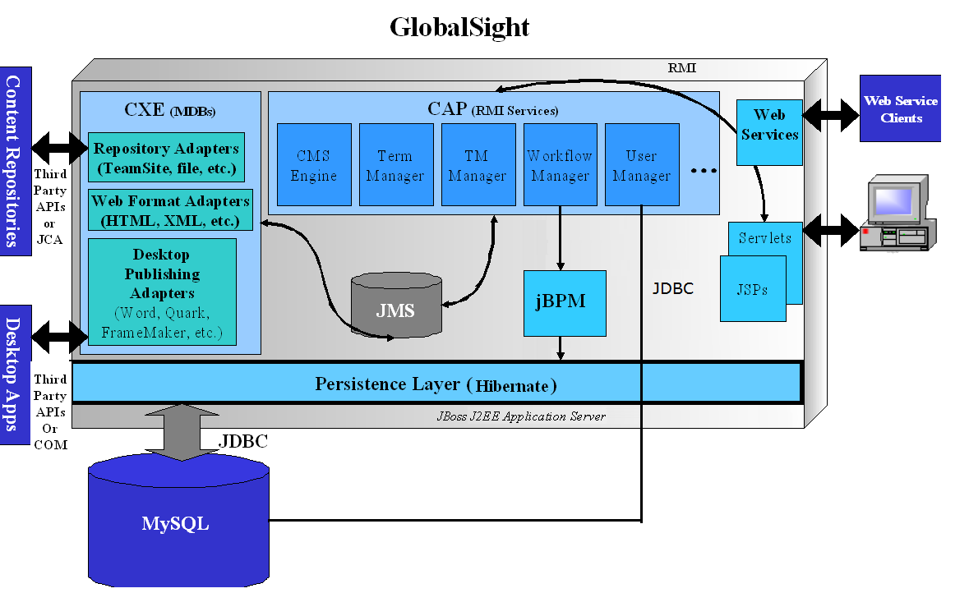
Architecture – CAP and CXE
Notes:
CAP ( Content Adaptation Platform ) – only cover bolded stuff to shorten
- user management and security (authentification, profiles, roles)
- user interface (MVC – ControlServlet, PageHandler, Beans, JSP, HTML extensible to WML)
- database persistence (RMI component, EJBs, Servlets, JDBC; bulk inserts, batch updates, caching)
- Workflow -> view on server (WorkflowServer component wraps jBPM API)
- translation memory -> view on server (truly multilingual, page and segment TM, extensive settings, maintenance, TMX compliance, import/export)
- Terminology (concept-based, loosely coupled)
- on-line editor and off-line editor handling (entirely web-based, extensive features, various export formats RTF, XLIFF, etc.)
- Reporting (2 dozen oob reports; extensible)
- Costing and Vendor Management
CXE…

Slide 2
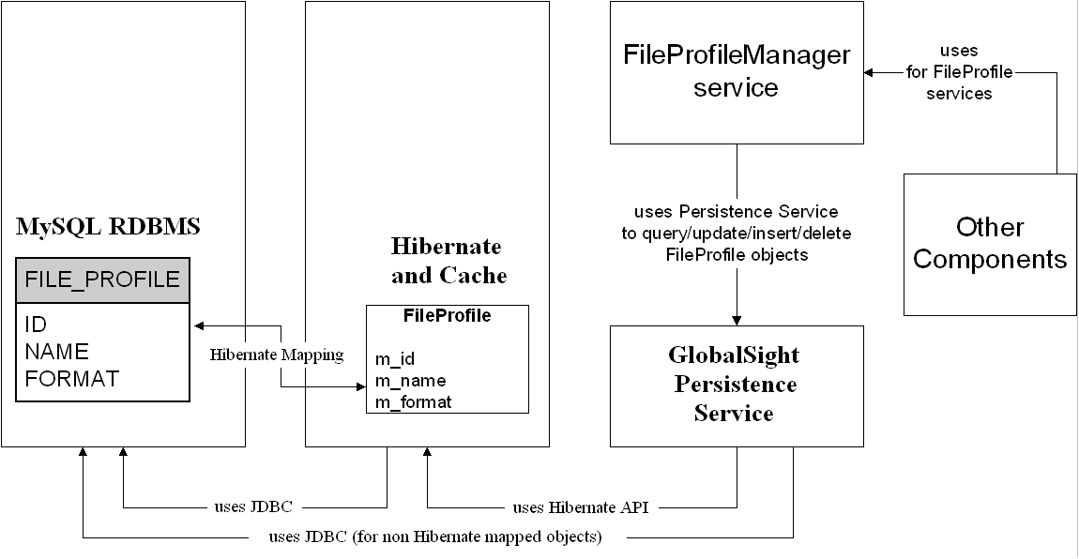
Use of Persistence Service

Slide 3
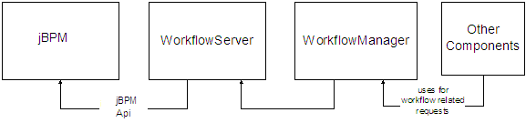
Workflow

Slide 4
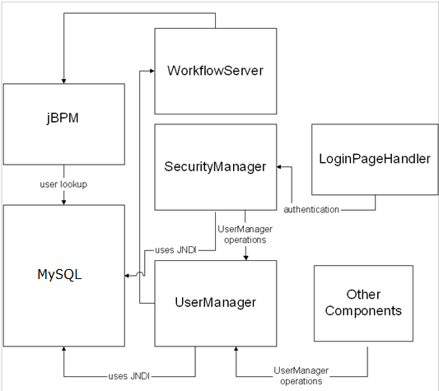
User Mangement

Slide 5
CXE Architecture

